Slide 1

CSCI101
Operating
Systems
Nile University
LAB 5 – WEEK 6
CSCI101 Team

Slide 2
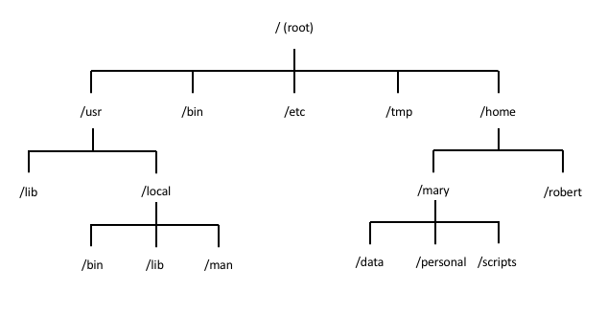
CSCI101
    Recap on File System Structure
Key directories
/ → Root directory.
/home → User directories.

Slide 3
CSCI101
    Lets Refresh! Question...
If I want to go to mary user directory what should I write in the path ?
Notes:
Ans: /home/mary

Slide 4
CSCI101
    The Basic Commands
Used for | Commands
Navigating Directories | ls → list files cd → change directory Pwd → print working directory
File Management | cp → copy mv → move rm → remove mkdir → make directory
Viewing Files | cat → read file less → read the first page in a file head → display first 5 rows in file tail → display last 5 rows in file
Creating File | touch
Getting Help about command | man --help

Slide 5
CSCI101
    Question...
"Have you ever wondered how you could run two operating systems on the same computer at the same time without deleting anything?"
Notes:
Ans: Yes we can make this through Virtual Box

Slide 6
CSCI101
    VirtualBox
Think of VirtualBox like a house that allows you to build many rooms, each with its own design. In our case, each ‘room’ is an operating system, and the ‘house’ is your actual computer
Definition -> VirtualBox is a software that allows you to run multiple operating systems, like Linux, on your existing computer, without the need to restart or delete anything.

Slide 7
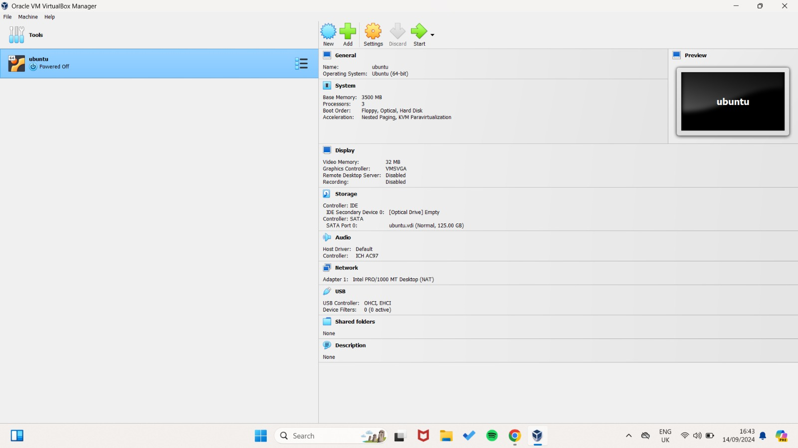
CSCI101
    VirtualBox Interface

Slide 8
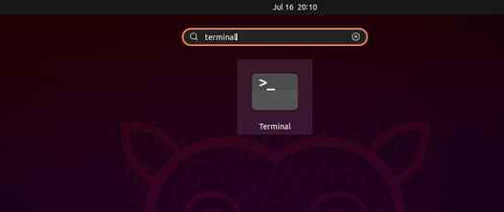
CSCI101
    Steps
Open your terminal in Linux

Slide 9

CSCI101
    Steps
command: pwd – Print current working directory.

Slide 10
CSCI101
    Steps
command: ls – List files in a directory.

Slide 11
CSCI101
    Steps
command: cd /path/to/directory – Change directories.
To go to Downloads for example:
How to return to home again?
1. Write → cd
Or
2. Write → cd ~

Slide 12

CSCI101
    Steps
Can we move from root ‘/’ to Downloads directly? No
we can by writing the whole path for the downloads like this:
Or just writing
cd ~/Downloads

Slide 13

CSCI101
    Steps
command: mkdir – Create a directory.
Look here folder created successfully

Slide 14
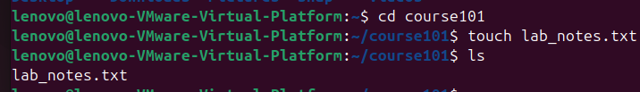
CSCI101
    Steps
command: touch filename.txt – Create a file.
Look here file created successfully

Slide 15
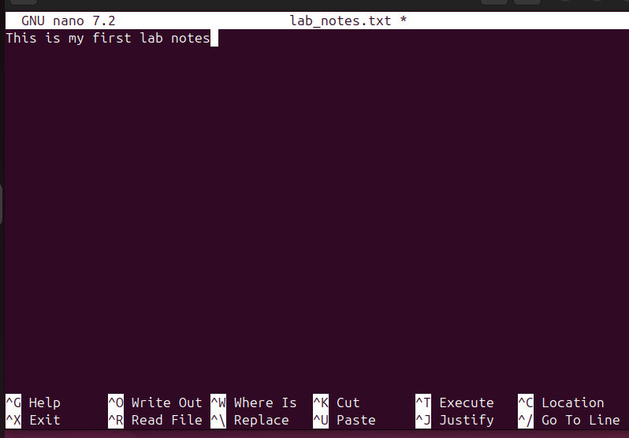
CSCI101
    How to Write in a File: Steps
command: nano filename.txt
Then enter
This page will appear
Write anything here

Slide 16
CSCI101
    How to Write in a File: Steps
2. command: echo used to display text, but it can also be used to write to a file.
Ex1: echo “This is my second line in my notes" > lab_notes.txt
This will create a file called lab_notes.txt and write “This is my second line in my notes" to it.
If lab_notes.txt already exists, it will overwrite the content of the file.
Ex2: echo “This is my second line in my notes" >> lab_notes.txt
To add content without overwriting the existing file, use >> instead of >.

Slide 17
CSCI101
    How to View Content of a File: Steps
command: cat filename.txt , Also head, tail and less commands are used
Note commands differences
cat - Display the contents of a file
head - Display the first few lines of a file.
tail - Display the last few lines of a file.
less - View the contents of a file page by page.

Slide 18

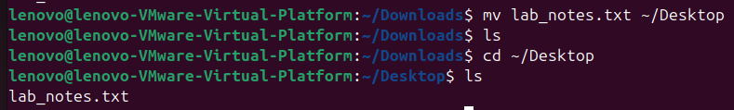

CSCI101
    How to View Content of a File: Steps
command: cp File.txt /copyLocation → Copy a file.
command: mv File.txt /newLocation → Move a file.
command: rm File.txt → Delete a file.
Look file copied from csci101 folder to Downloads successfully
Look file moved from Downloads to Desktop successfully
Look deleted successfully

Slide 19
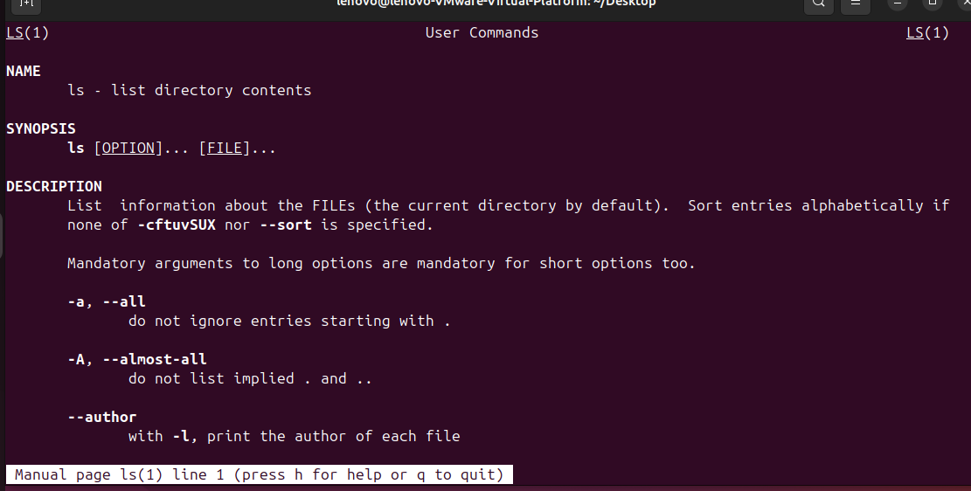
    How to Get Help For a Specific Command: Steps
CSCI101
using man → Display the manual for a command.
Syntax: man command_name

Slide 20
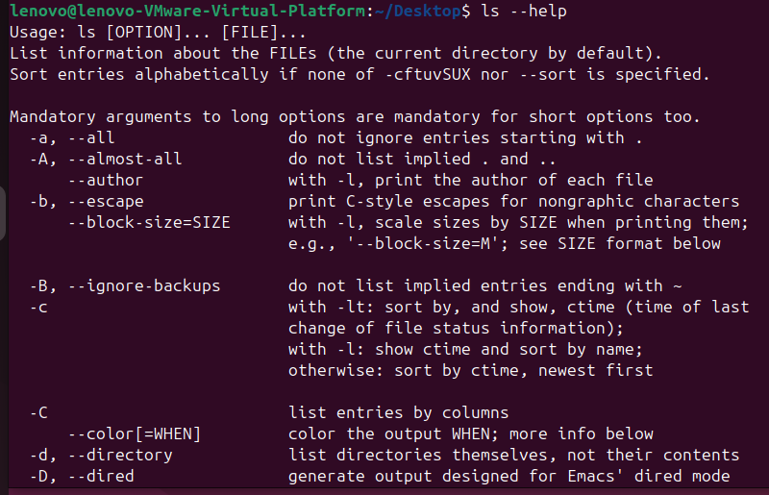
    How to Get Help For a Specific Command: Steps
CSCI101
using man → Display the manual for a command.
Syntax: man command_name

Slide 21


CSCI101
    Lab Task
Task 1
File Management task
Create an empty file called Task.txt inside your home directory.
Write "Hello, World!" into the file Task.txt using the echo command.
Append "This is a test." to the same file.
Copy Task.txt to Desktop
Remove Task.txt from your home directory.
Congratulations on finishing your task

Slide 22

CSCI101
Version Control
(Git)
Nile University
LAB 5 – WEEK 6
CSCI101 Team

Slide 23
Agenda
CSCI101
1
Creating your Github account
  Task
  2

Slide 24
CSCI101
    Github
Creating Your GitHub Account

Slide 25
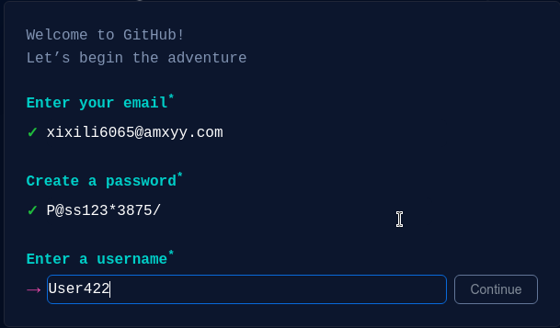
Go to github.com
Enter Your Email and Password

Slide 26
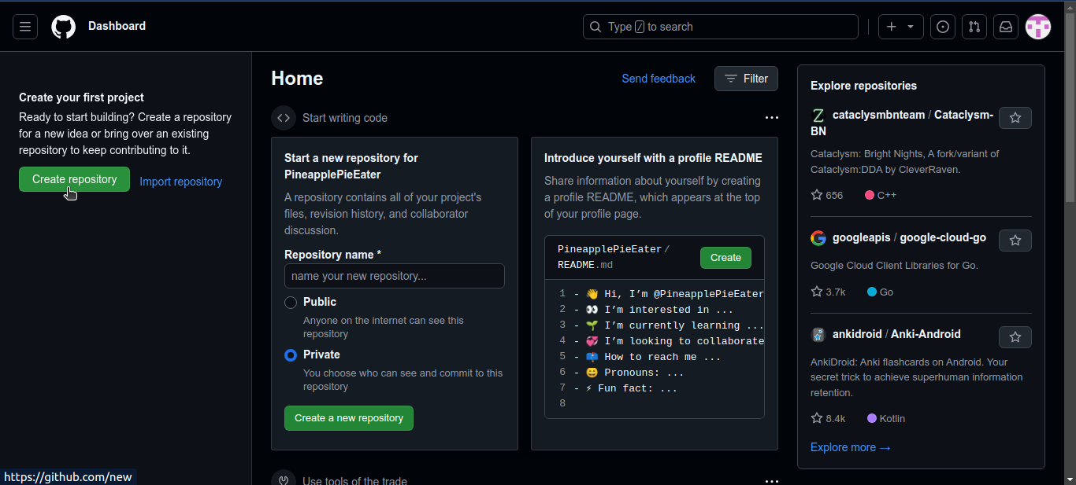
CSCI101
    Create a Repository

Slide 27
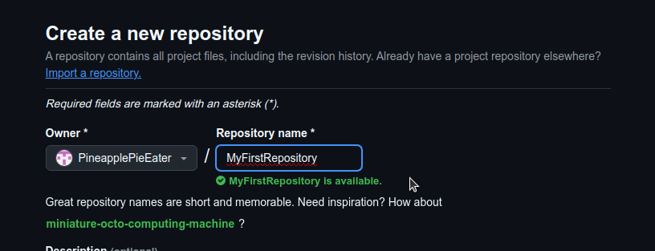
CSCI101
    Create a Repository
Name your repository & Create it

Slide 28
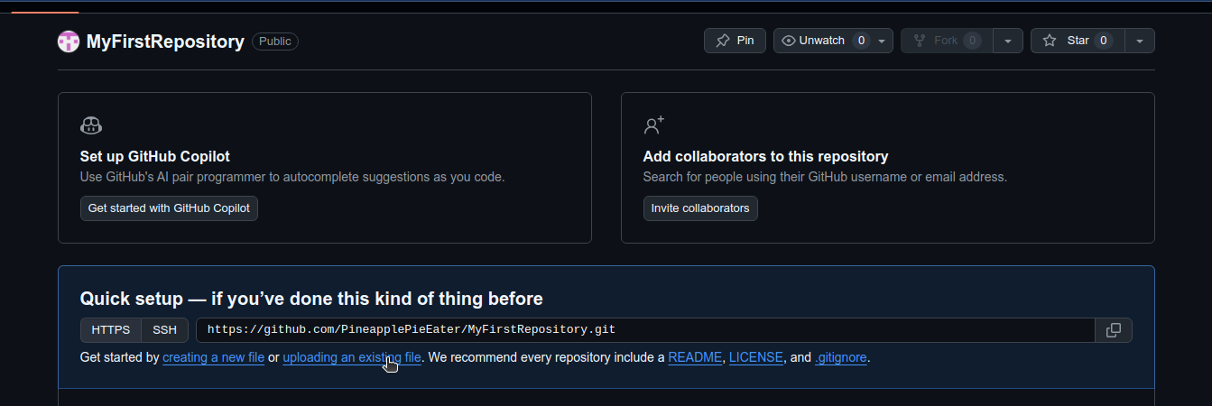
    Upload Your Document to Your Repository
CSCI101
Choose your file and upload it

Slide 29
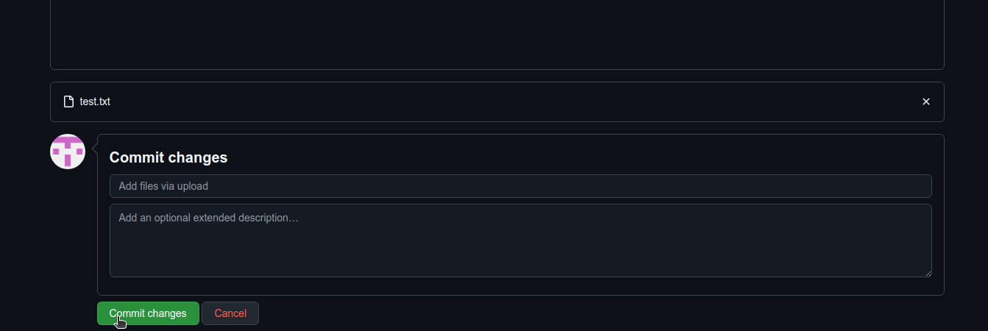
CSCI101
    Commit Your Changes

Slide 30
CSCI101
    Done!
CONGRATS!
YOU MADE YOUR FIRST COMMIT

Slide 31
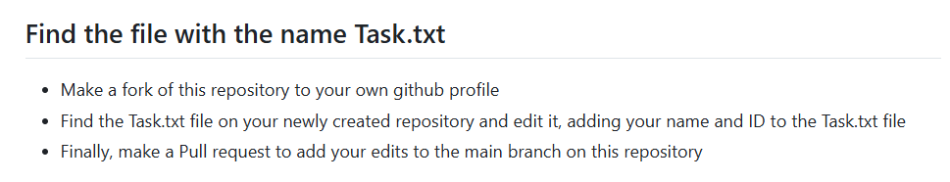
CSCI101
    Lab Task
Task
  Make a pull request on “Task.txt” in this repository <repo_link>

Slide 32

CSCI101
THANK YOU
Any Questions?
Nile University
End Slide

